Slide 1
Introducción a los gráficos en R
Guillermo Durán González

Slide 2
Gráficos

Slide 3
Conjunto de datos Cars
Accediendo el conjuto de datos cars
data(cars)
Para tener una visión de los datos de Cars
head(cars)
speed dist 1 4 2 2 4 10 3 7 4 4 7 22 5 8 16 6 9 10

Slide 4
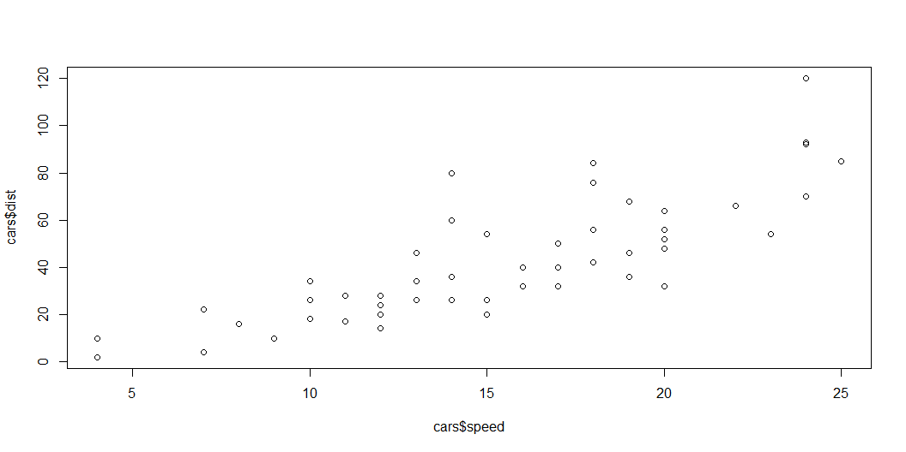
Gráficos con Plot
Examinando el dataset con plot()
plot(cars$dist ~ cars$speed)

Slide 5
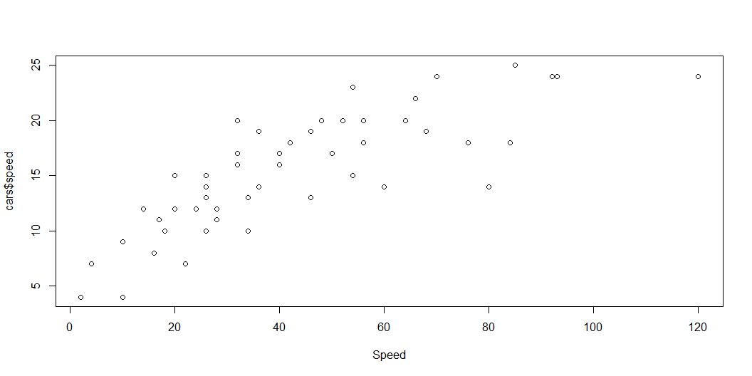
Etiquetas
Eje X:
plot(x = cars$dist, y = cars$speed, xlab="Speed")

Slide 6
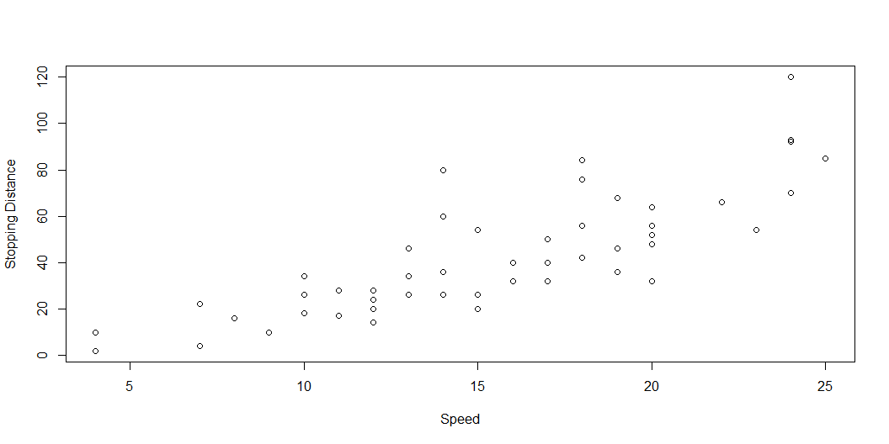
Ejes X e Y:
plot(x = cars$speed, y = cars$dist, xlab="Speed", ylab="Stopping Distance")

Slide 7
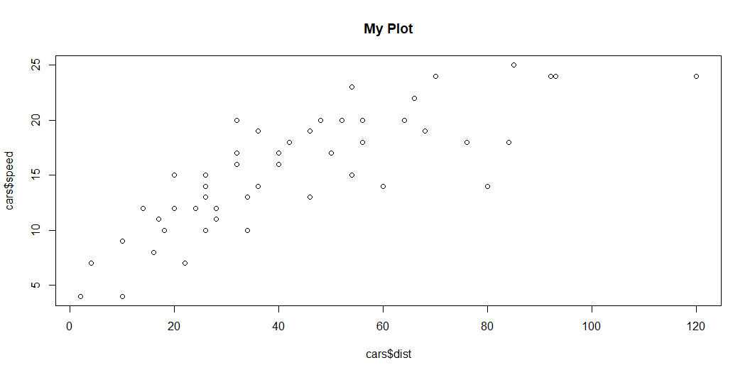
Títulos y subtítulos en plot:
Título:
plot(x = cars$dist, y = cars$speed, main="My Plot")

Slide 8
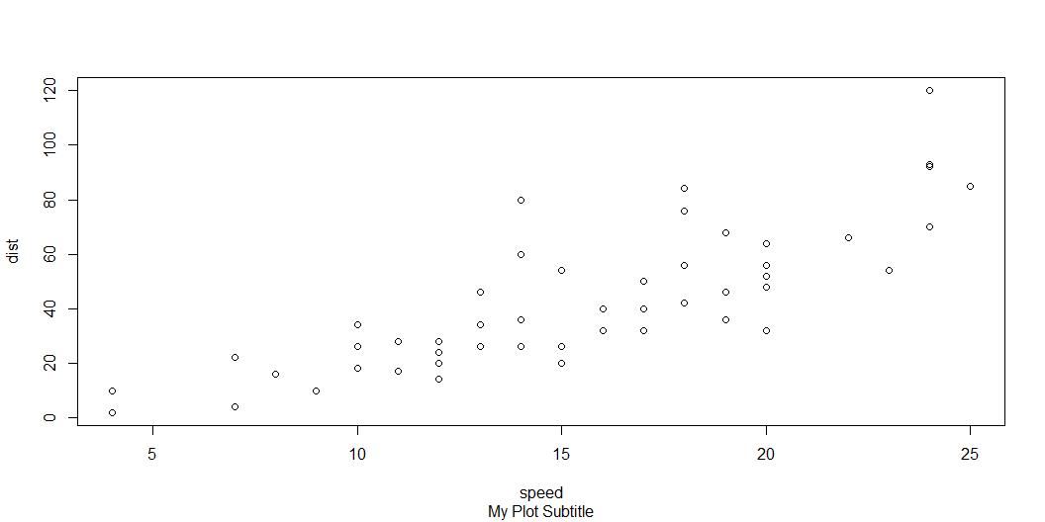
Subtítulo:
plot(cars, sub = "My Plot Subtitle")

Slide 9
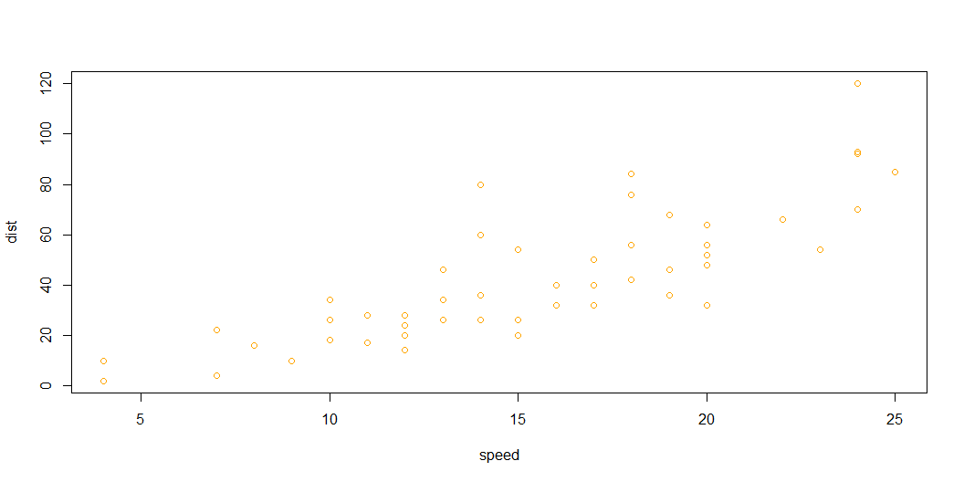
Color
plot(cars, col="orange")

Slide 10
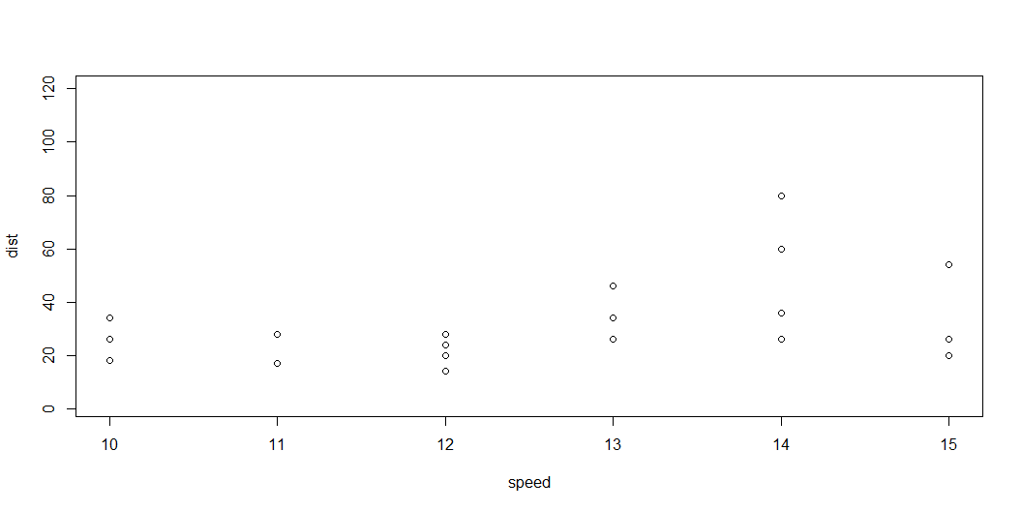
delimitando los ejes
Eje X:
plot(cars, xlim=c(10,15))

Slide 11
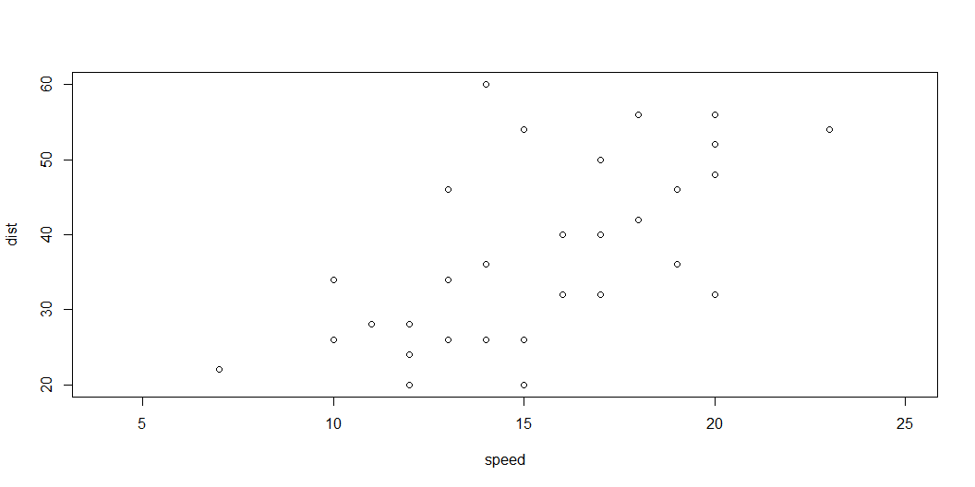
Eje Y:
plot(cars, ylim=c(20,60))

Slide 12
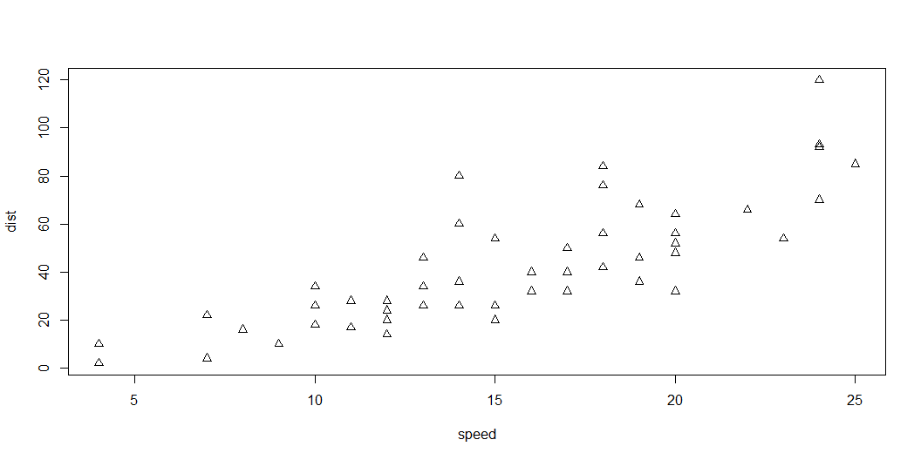
Formas de los puntos
plot(cars, pch=2, type="p")

Slide 13
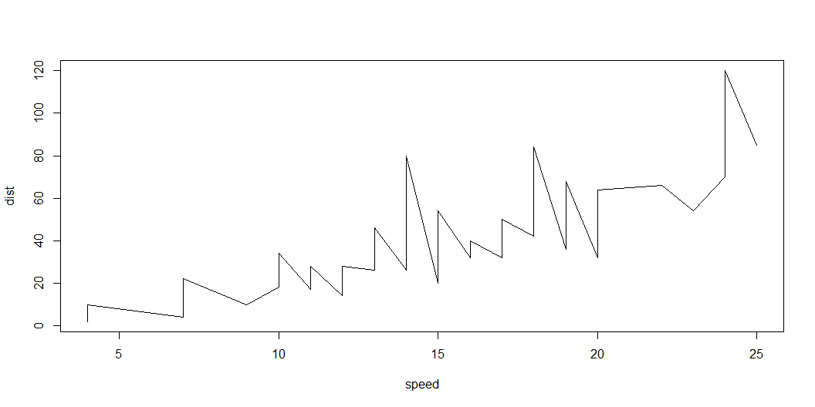
Tipos de Gráficos
plot(cars, type="l")

Slide 14
Dataset mtcars

Slide 15
Carga del data set
data(mtcars)

Slide 16
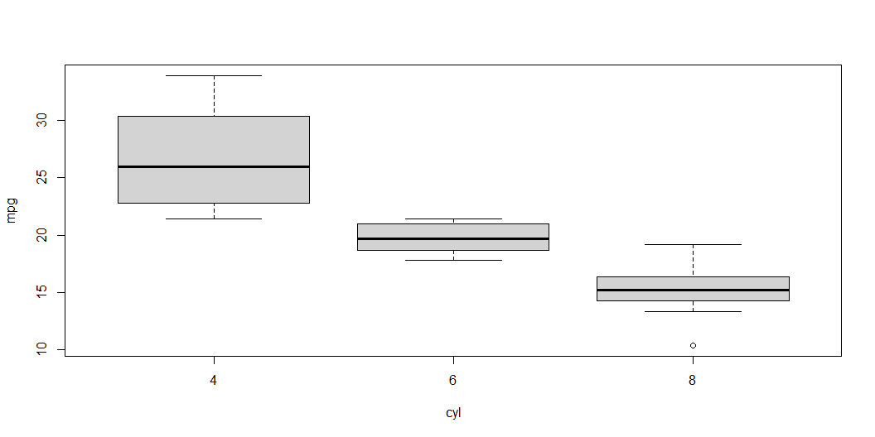
Gráficos boxplot
Fórmula
boxplot(formula = mpg ~ cyl, data = mtcars)

Slide 17
boxplot(mpg ~ cyl, mtcars)

Slide 18
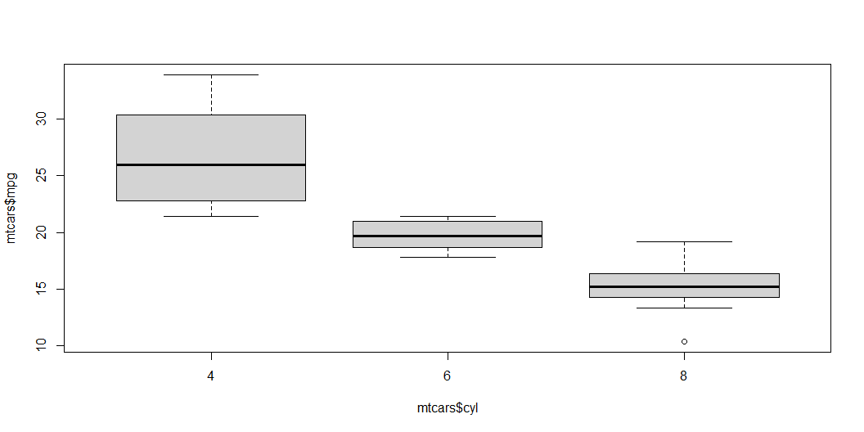
boxplot(mtcars$mpg ~ mtcars$cyl)

Slide 19
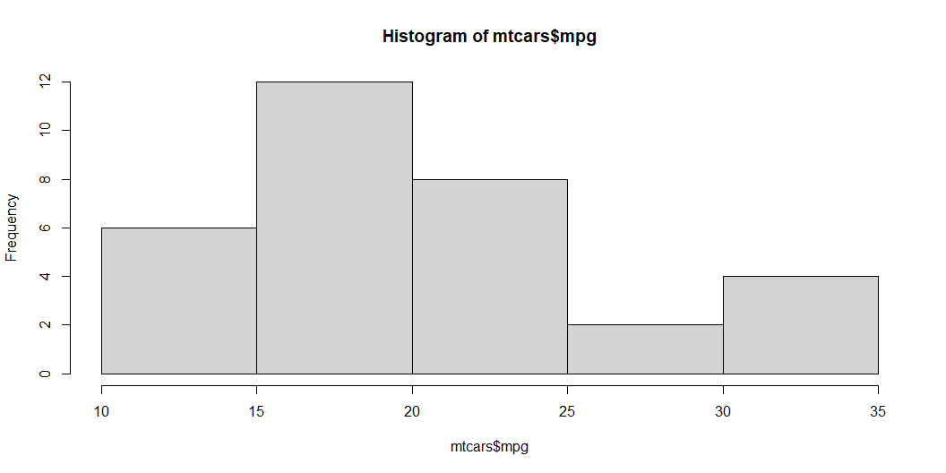
Gráficos histograma
Un ejemplo de histograma:
hist(mtcars$mpg)

Slide 20
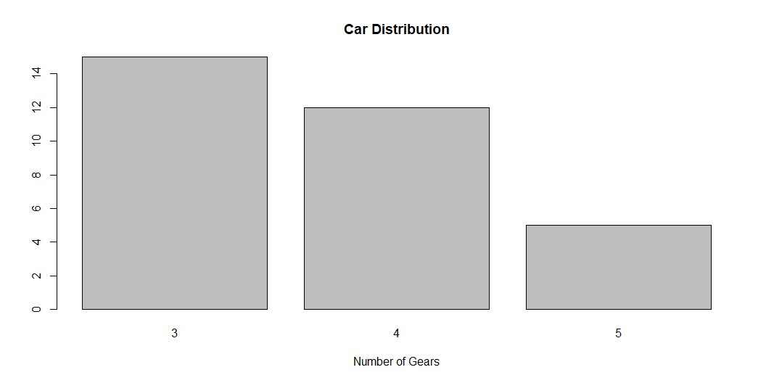
Gráficos barplot
counts <- table(mtcars$gear) barplot(counts, main="Car Distribution", xlab="Number of Gears")

Slide 21
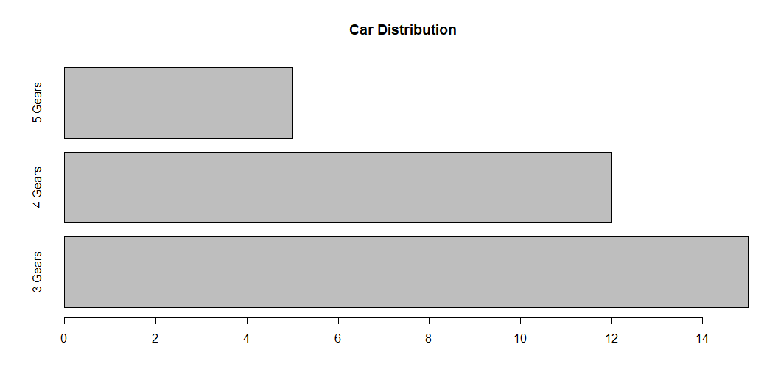
De columnas a barras
counts <- table(mtcars$gear) barplot(counts, main="Car Distribution", horiz=TRUE, names.arg=c("3 Gears", "4 Gears", "5 Gears"))

Slide 22
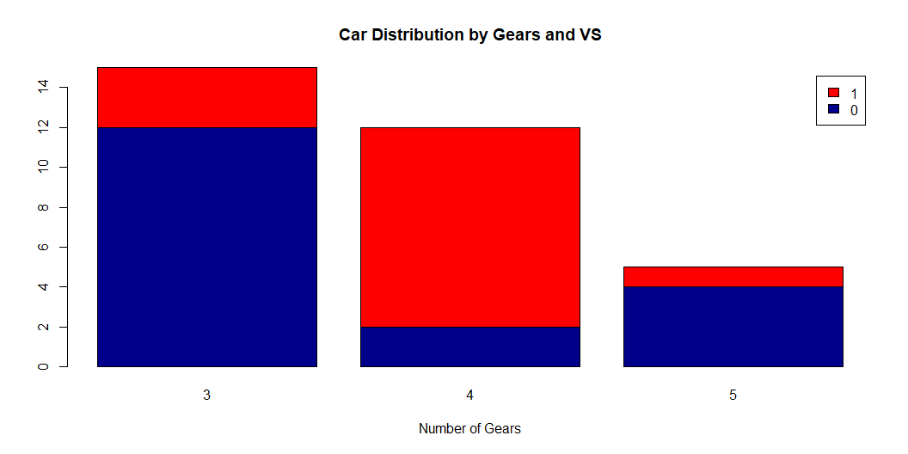
Columnas apiladas en colores
counts <- table(mtcars$vs, mtcars$gear) barplot(counts, main="Car Distribution by Gears and VS", xlab="Number of Gears", col=c("darkblue","red"), legend = rownames(counts))

Slide 23
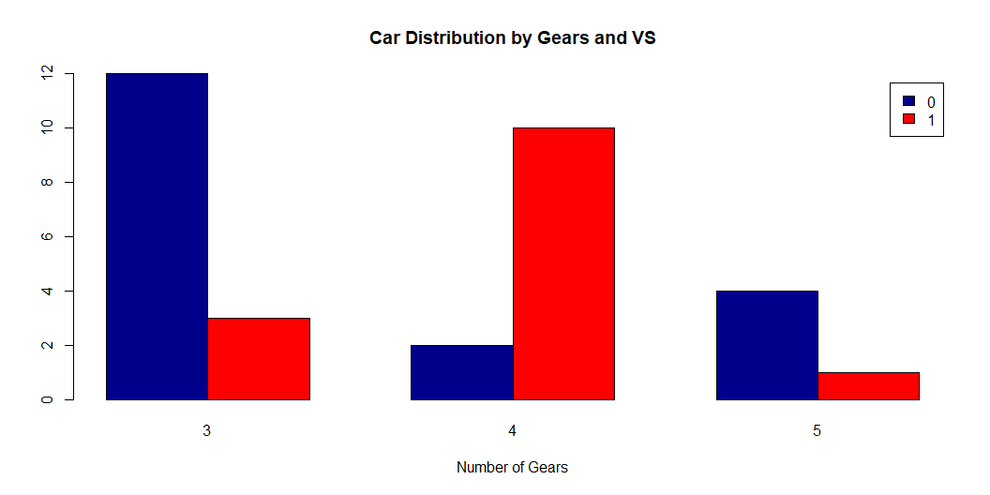
Columnas juntas
counts <- table(mtcars$vs, mtcars$gear) barplot(counts, main="Car Distribution by Gears and VS", xlab="Number of Gears", col=c("darkblue","red"), legend = rownames(counts), beside=TRUE)

Slide 24
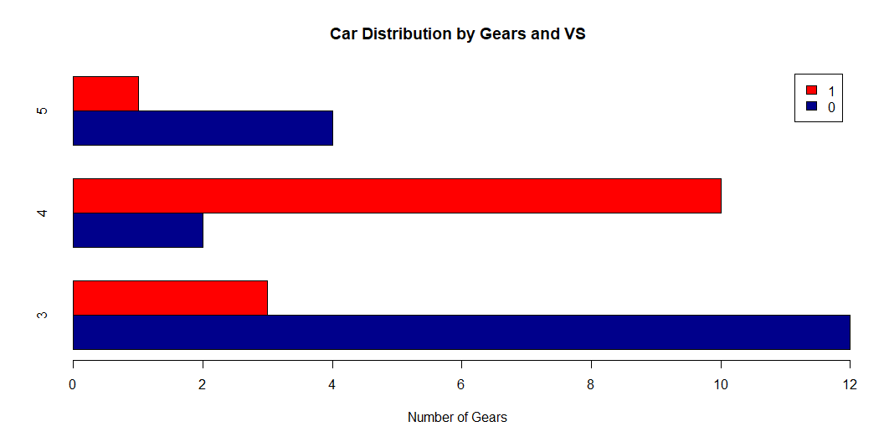
Barras juntas
counts <- table(mtcars$vs, mtcars$gear) barplot(counts, main="Car Distribution by Gears and VS", xlab="Number of Gears", col=c("darkblue","red"), legend = rownames(counts), beside=TRUE, horiz=TRUE)

